Slide 1
Medically-Supportive Food and Nutrition: California’s Opportunity to Expand Access to Food Supports through Medi-Cal

Slide 2
So what is Medically Supportive Food and Nutrition?

Slide 3
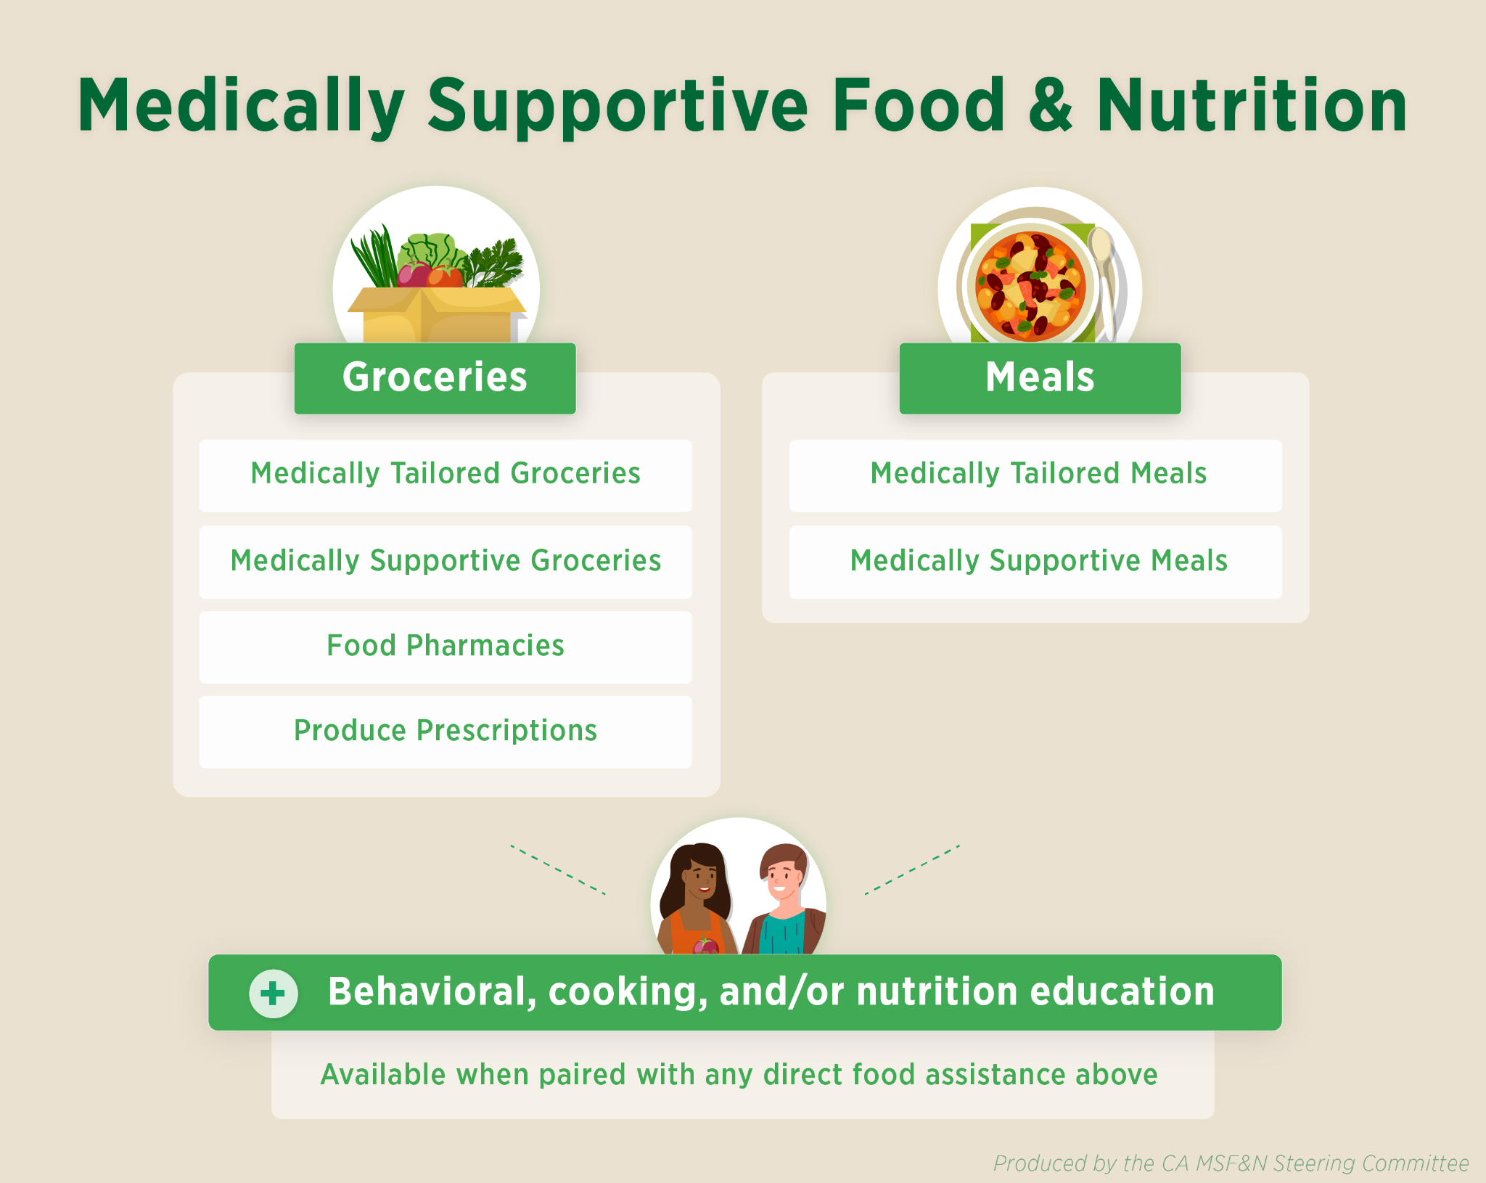

Slide 4
Our Goal
Medically supportive food and nutrition interventions are covered benefits in Medi-cal (Californians health insurance program for low-income Californians).

Slide 5
The Opportunity in California

Slide 6
Administrative Pathway to Covering Medically-Supportive Food & Nutrition
CalAIM: California Advancing and Innovating Medi-Cal
Community Supports (formerly In Lieu of Services): Flexible wrap-around services provided as a substitute, or to avoid, other Medi-Cal covered services such as ER utilization, a hospital or skilled nursing facility admission, or a discharge delay.
Notes:
primary goals of the CalAim initiative include 1) addressing SDOH and 2) improve quality outcomes and delivery system improvements through value based initiatives

Slide 7
Logistics

Slide 8
Launch Webinar & Assessment Survey
Webinar- Friday July 22nd 12-1pm
Organizations that provide or are interested in providing ANY of the eligible CalAIM medically supportive food and nutrition Community Supports are encouraged to attend the webinar
Survey launches 7/22 and must be completed by EOD 8/5
Notes:
https://us06web.zoom.us/meeting/register/tZMtdeuopj0sE93ZnITYpTurhCZ1D_TQhf4g

Slide 9
Questions?

